Slide 1


DEPARTMENT OF ELECTRONICS AND COMMUNICATION ENGINEERING
SUSTAINABLE URBAN FARMING USING HYDROPONICS
GUIDED BY :
Mrs.D.PUSHPALATHA ,M.E.
AP/ECE

Slide 2
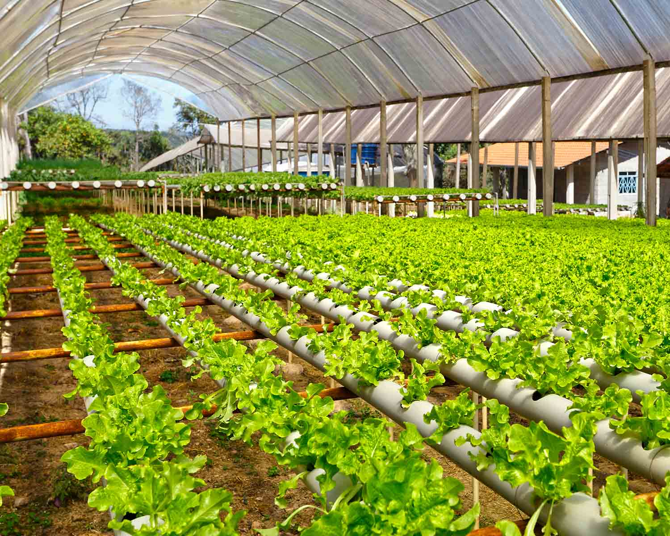
TEAM MEMBERS
M.ARTHI (927622BEC016)
S.DEEPIKA (927622BEC029)
R.DHARSHNA (927622BEC040)

Slide 3
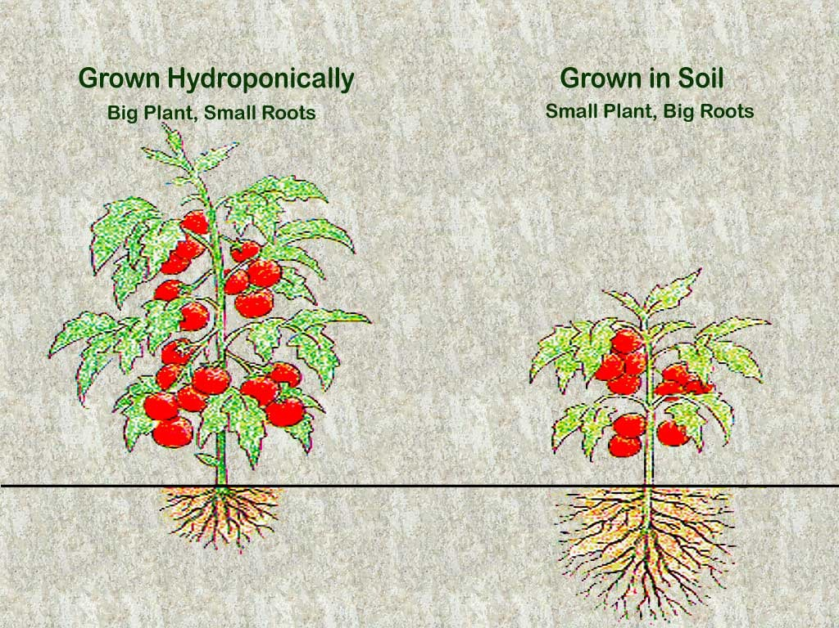
PROBLEM STATEMENT
By 2050, we will need to increase food production by about 70% in order to meet the caloric needs of a global population of 9.8 billion people.
68% of whom are projected to live in urban areas.
38% of earth’s non-frozen land is used for growing food.
This percentage will continue to rise: by 2050, 593 million hectares of land will need to be transformed into agricultural land

Slide 4
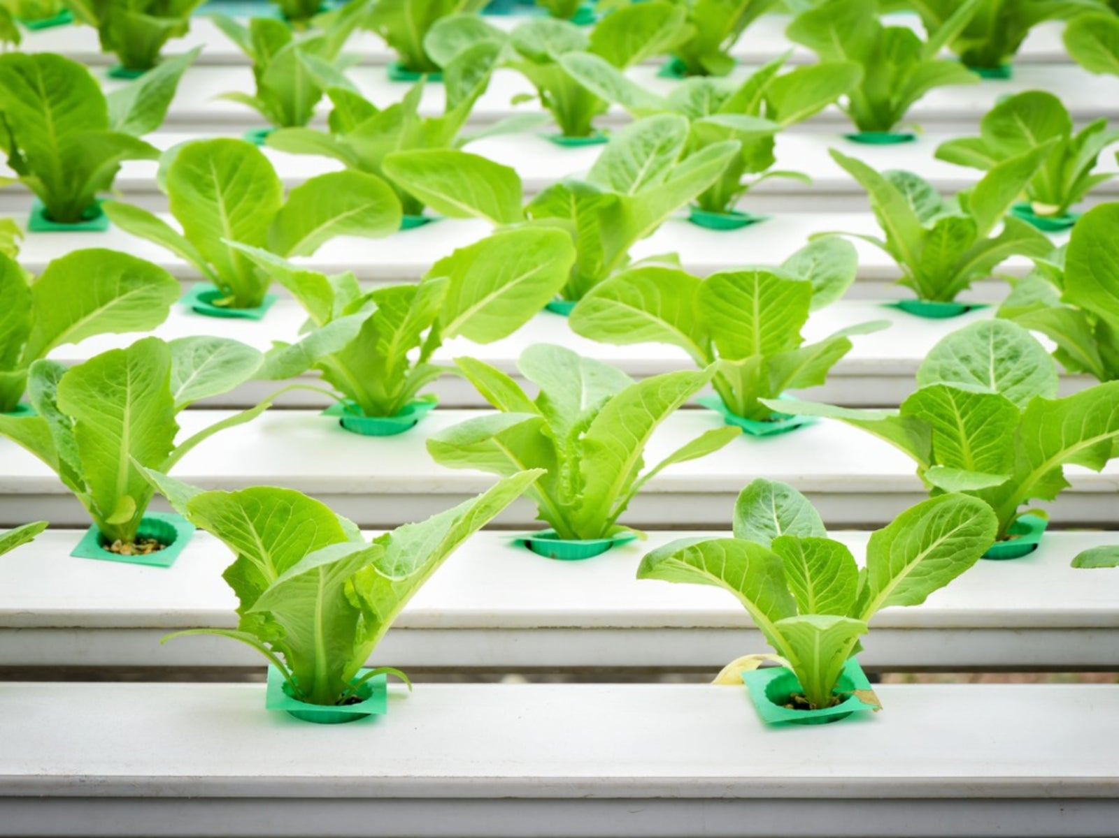
OBJECTIVE
The main objective of this project is to create an automated hydroponics system that uses the Blink app to monitor and control various aspects of plant growth, such as nutrient levels, light, and temperature, in real-time. This aims to optimize plant growth and resource use in a sustainable and efficient manner.

Slide 5
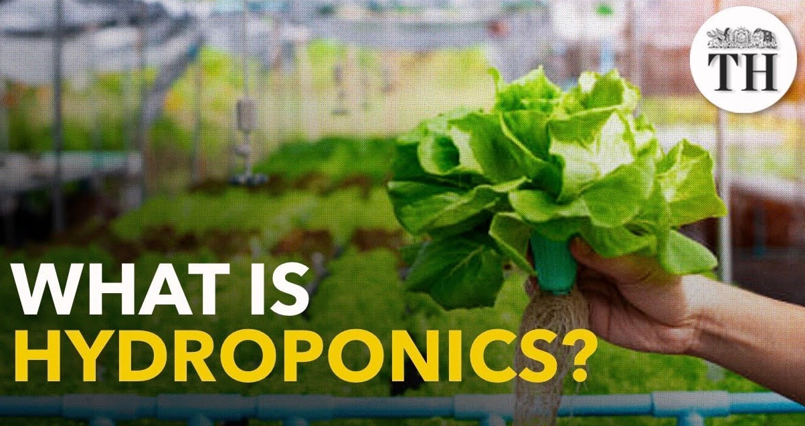
ABSTRACT
This project focuses on developing an IoT-based hydroponic farming system to automate the monitoring and control of key environmental factors, optimizing plant growth. Hydroponics, a soilless farming method, addresses urban agriculture challenges like limited space, water scarcity, and inefficient resource use. The system uses sensors such as DHT for temperature and humidity and a soil moisture sensor to monitor water levels, with the ESP8266 microcontroller enabling real-time monitoring via the Blynk app. Automated processes like irrigation and lighting control reduce manual effort and water wastage, while alerts ensure timely action for parameter fluctuations, promoting sustainable and efficient urban farming.

Slide 6
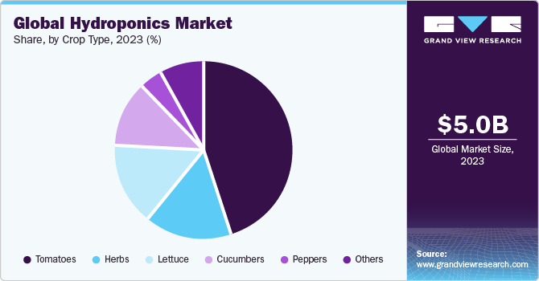
LITERATURE SURVEY
M. Butturini et al.Chapter 4 - vertical farming in Europe: Present status and outlookL. Casey et al.Comparative environmental footprints of lettuce supplied by hydroponic controlled-environment agriculture and field-based supply chainsJ. Clean. Prod.(2022)
“Supachai Puengsungwan”, “Internet of Things (IoT) based hydroponic lettuce farming with solar panels”, - IEEE, 2019.
“Tharindu Madushan Bandara”, “Smart farm and monitoring system for measuring the Environmental condition using wireless sensor network-IOT Technology in farming”, - IEEE, 2020.

Slide 7
EXISTING SYSTEM
Traditional land-based agriculture relies on natural sunlight for plant growth, with no artificial light supplementation.
Watering is done manually or through basic irrigation systems like drip or sprinklers, without automation.
Plants are grown directly in soil, which serves as both a support structure and nutrient source.
Environmental monitoring is limited, with no advanced sensors to track moisture, temperature, or humidity.
Tasks such as watering, fertilizing, and pest control are performed manually and require constant human effort.
There is little real-time data integration for environmental conditions, leading to inefficiencies and inconsistent yields.
Traditional methods are resource-intensive, with inefficient use of water, energy, and space.
The system is integrated with the Blink app, allowing remote monitoring and control of components such as lighting, watering cycles, and environmental conditions via smartphones, with real-time data on moisture, temperature, and humidity, ensuring optimal plant growth from anywhere.

Slide 8
PROPOSED SYSTEM
Sustainable urban farming with hydroponics integrates agriculture into urban spaces, addressing food security, sustainability, and resilience.
The system uses a vertical or stacked arrangement to optimize space, supported by a nutrient-enriched water reservoir that nourishes plant roots.
A luminous bulb is used to simulate sunlight, ensuring plants receive adequate light for growth.
A moisture sensor monitors soil moisture levels and activates a water pump for precise watering.
The ESP8266 microcontroller collects data from sensors and controls components like the luminous bulb and water pump.
A DHT sensor measures temperature and humidity to maintain optimal environmental conditions.
Automation ensures efficient operation with scheduled watering and lighting cycles, promoting sustainable food production in urban environments.

Slide 9
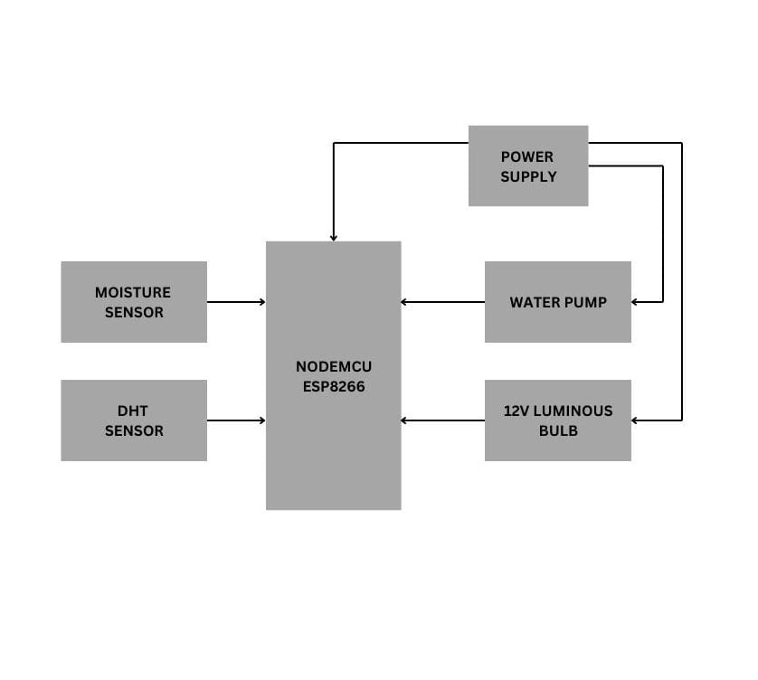
BLOCK DIAGRAM

Slide 10
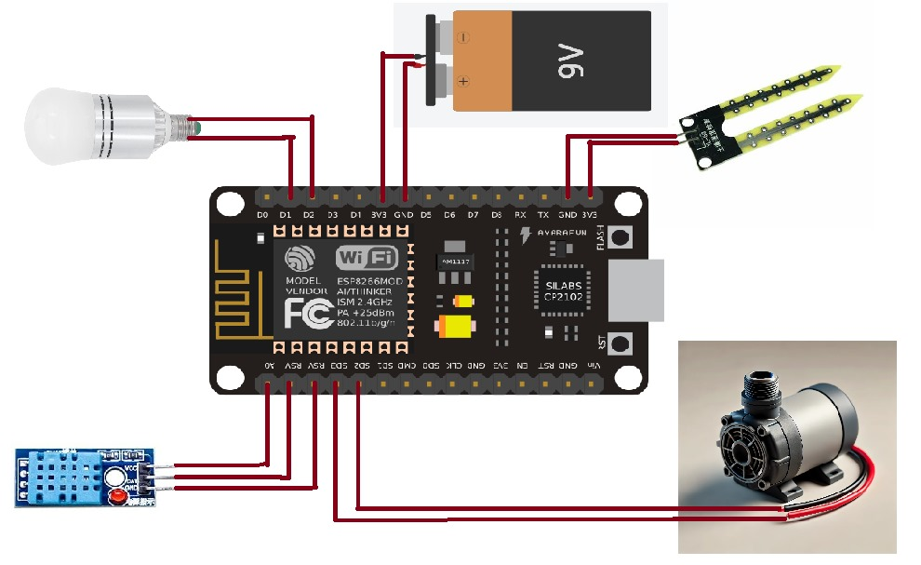
CIRCUIT DAIGRAM OF PROPOSED SYSTEM

Slide 11
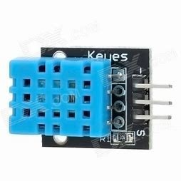
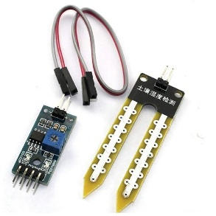
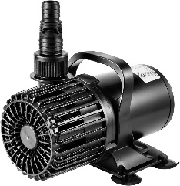
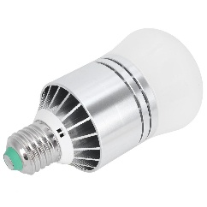
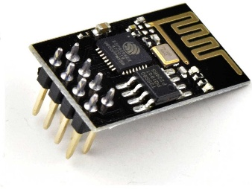
COMPONENTS
DHT Sensor
Moisture Sensor
Water Pump
12V Induction Bulb
ESP8266

Slide 12
WORKING PRINCIPLE
The proposed hydroponic system uses vertical or stacked arrangements to maximize space efficiency and a nutrient-enriched water reservoir for direct nourishment of plant roots.
A luminous bulb simulates sunlight, ensuring plants receive the necessary light for growth.
Moisture sensors monitor soil moisture levels, activating a water pump to deliver water precisely when needed.
The ESP8266 microcontroller collects data from sensors like moisture sensors and DHT sensors, which track temperature and humidity.
Automation adjusts watering cycles and lighting schedules to ensure energy efficiency and consistent system operation.
The system integrates sensors, microcontrollers, and automated components to create an efficient, sustainable urban farming solution with higher food production in limited spaces.

Slide 13
CONT…
The system is integrated with the Blink app, enabling remote monitoring and control of key components like lighting, watering cycles, and environmental conditions via smartphones.
The app connects to the ESP8266 microcontroller, providing real-time data on moisture levels, temperature, and humidity.
Users can make adjustments through the app, ensuring optimal conditions for plant growth from anywhere.

Slide 14
METHODOLOGY
The hydroponic system uses a vertical or stacked arrangement to maximize space efficiency, with a nutrient-enriched water reservoir delivering essential nutrients to plant roots.
A luminous bulb simulates sunlight, providing necessary light for photosynthesis in areas with limited natural sunlight.
Moisture sensors monitor moisture levels in the growing medium and trigger a water pump to deliver water when needed, while a DHT sensor tracks temperature and humidity to maintain optimal conditions for plant growth.
An ESP8266 microcontroller collects data from the sensors and makes decisions such as activating the water pump or adjusting the lighting.

Slide 15
CONT…
Automation controls watering schedules and lighting cycles, ensuring energy efficiency and minimizing human intervention.
The system is designed to be energy- and resource-efficient, minimizing water and energy consumption.
The Blink app is integrated for remote monitoring and control of environmental parameters like moisture, temperature, and humidity, providing real-time data for optimal plant growth.
The methodology creates an efficient, automated, and sustainable hydroponic system for urban farming.

Slide 16
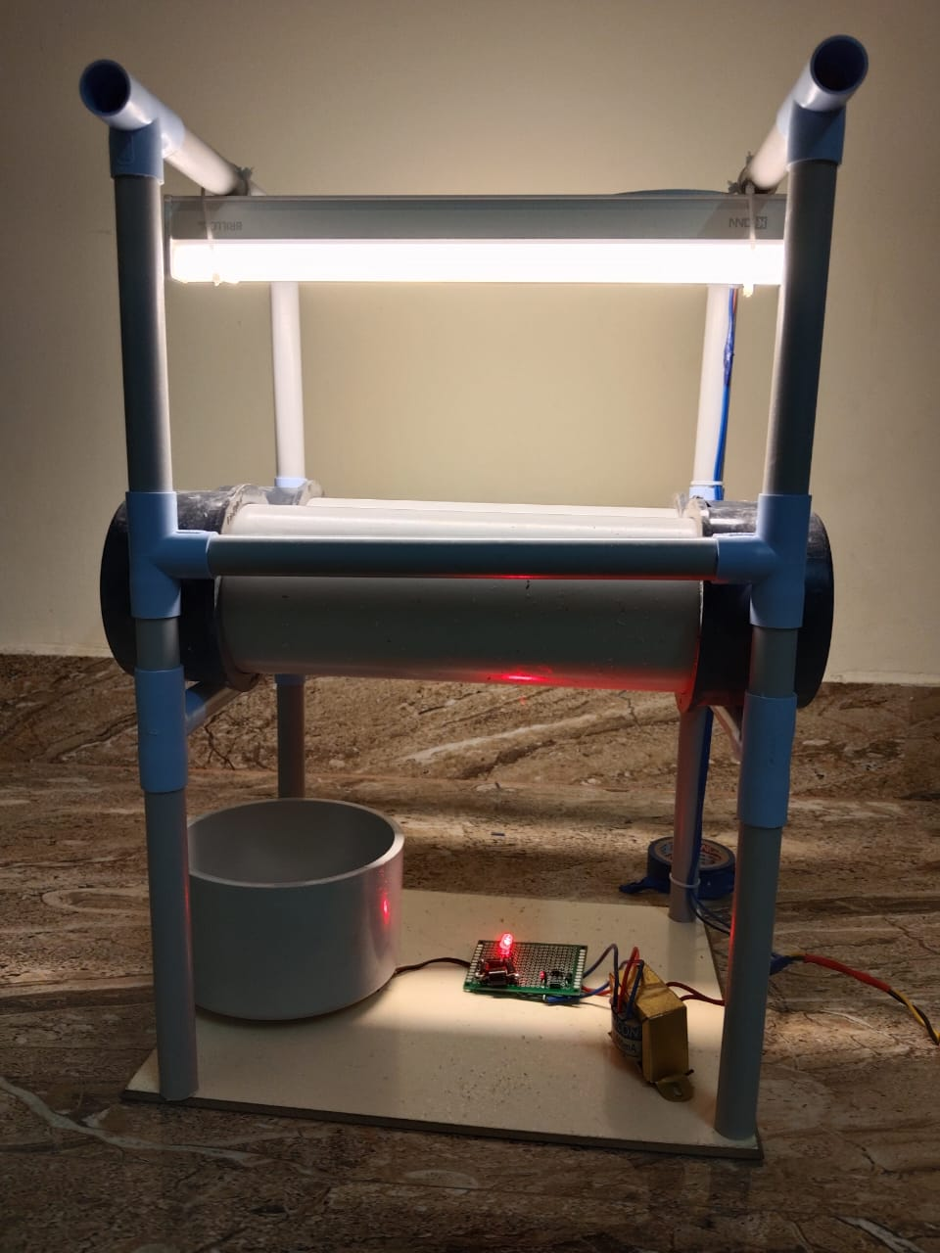
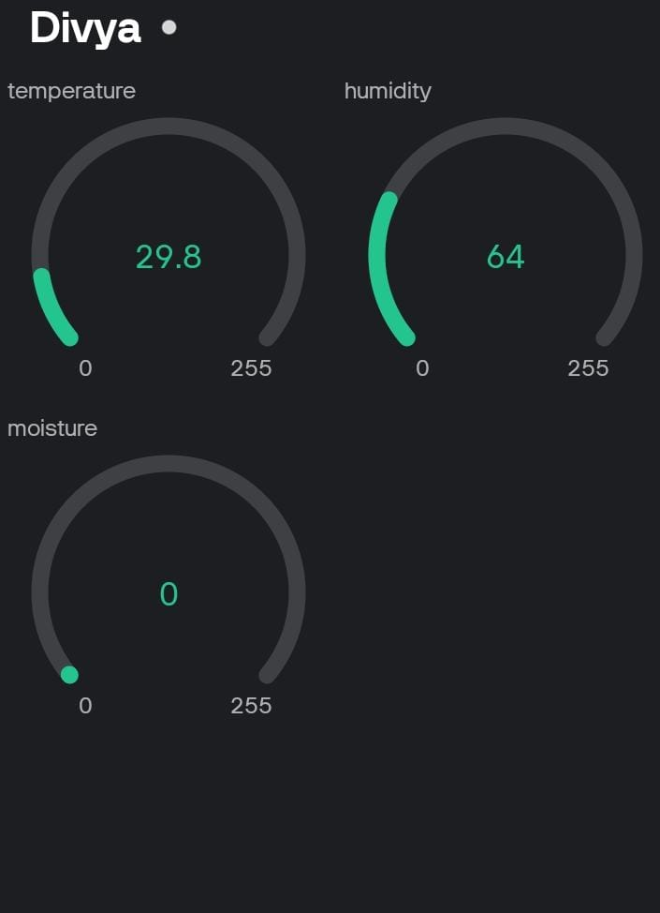
PROJECT OUTCOME

Slide 17
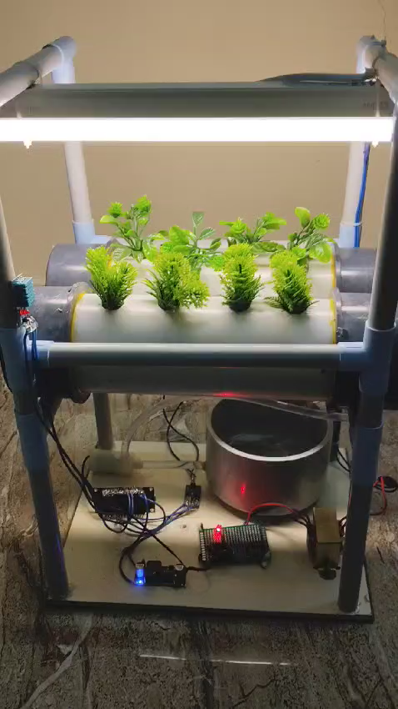

Slide 18
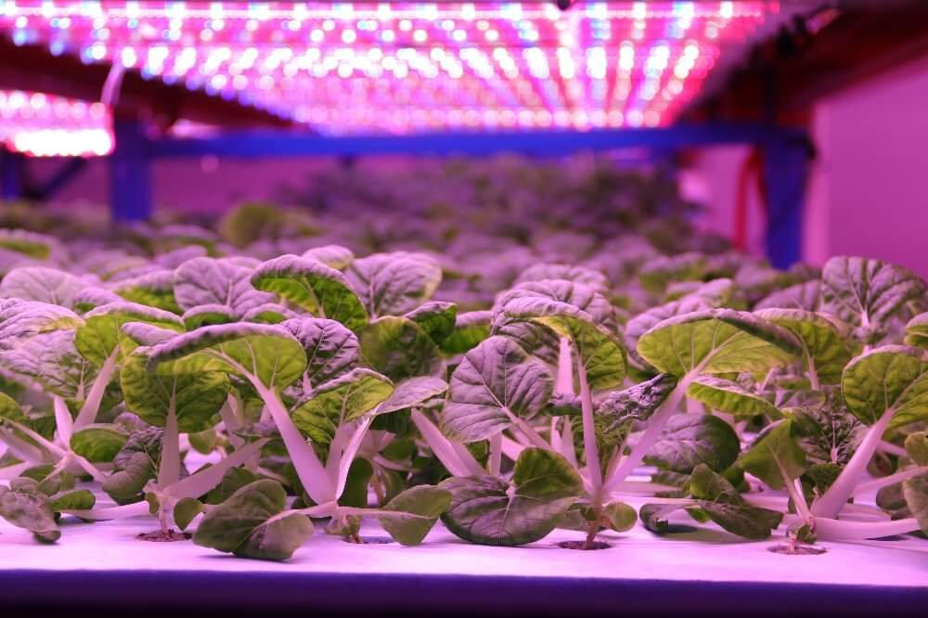
ADVANTAGES
Global food security
Hydroponics can help achieve sustainable food security by producing high-quality food in all regions of the world.
Resource conservation
Hydroponics uses fewer resources than conventional farming.
Water conservation
Hydroponics allows you to precisely deliver the exact amount of water each plant needs, without wasting any.
Biodiversity
Urban farms can increase biodiversity in cities by providing habitats for various species.

Slide 19
REFERENCE
1. Resh, H. M. (2012). Hydroponic Food Production. CRC Press.
2. Jones, J. B. (2016). Hydroponics: A Practical Guide for the Soilless Grower. CRC Press.
3. Despommier, D. (2010). The Vertical Farm: Feeding the World in the 21st Century. Macmillan.
4. Banerjee, C., & Adenaeuer, L. (2014). "Up, Up and Away! The Economics of Vertical Farming." Journal of Agricultural Studies, 2(1), 40-60.
5. McClintock, N. (2010). "Why Farm the City? Theorizing Urban Agriculture through Environmental Justice." Geoforum, 41(2), 191-203.
6. Grewal, S. S., & Grewal, P. S. (2012). "Can Cities Become Self-Reliant in Food?" Cities, 29(1), 1-11.

Slide 20


